Slide 1
Emerging and Breakthrough Technologies
Platforms and Innovation
Vladimir C.M. Sobota

Slide 2
About me: Vladimir CM Sobota
Currently: PostDoc @ ETI
Interests: Platform ecosystems, competition at the platform-level, platform entrepreneurship, linkages with other literatures
Teaching: Strategic Management Game (minor ‘Companies and Value Sensitive Innovation’)

Slide 3

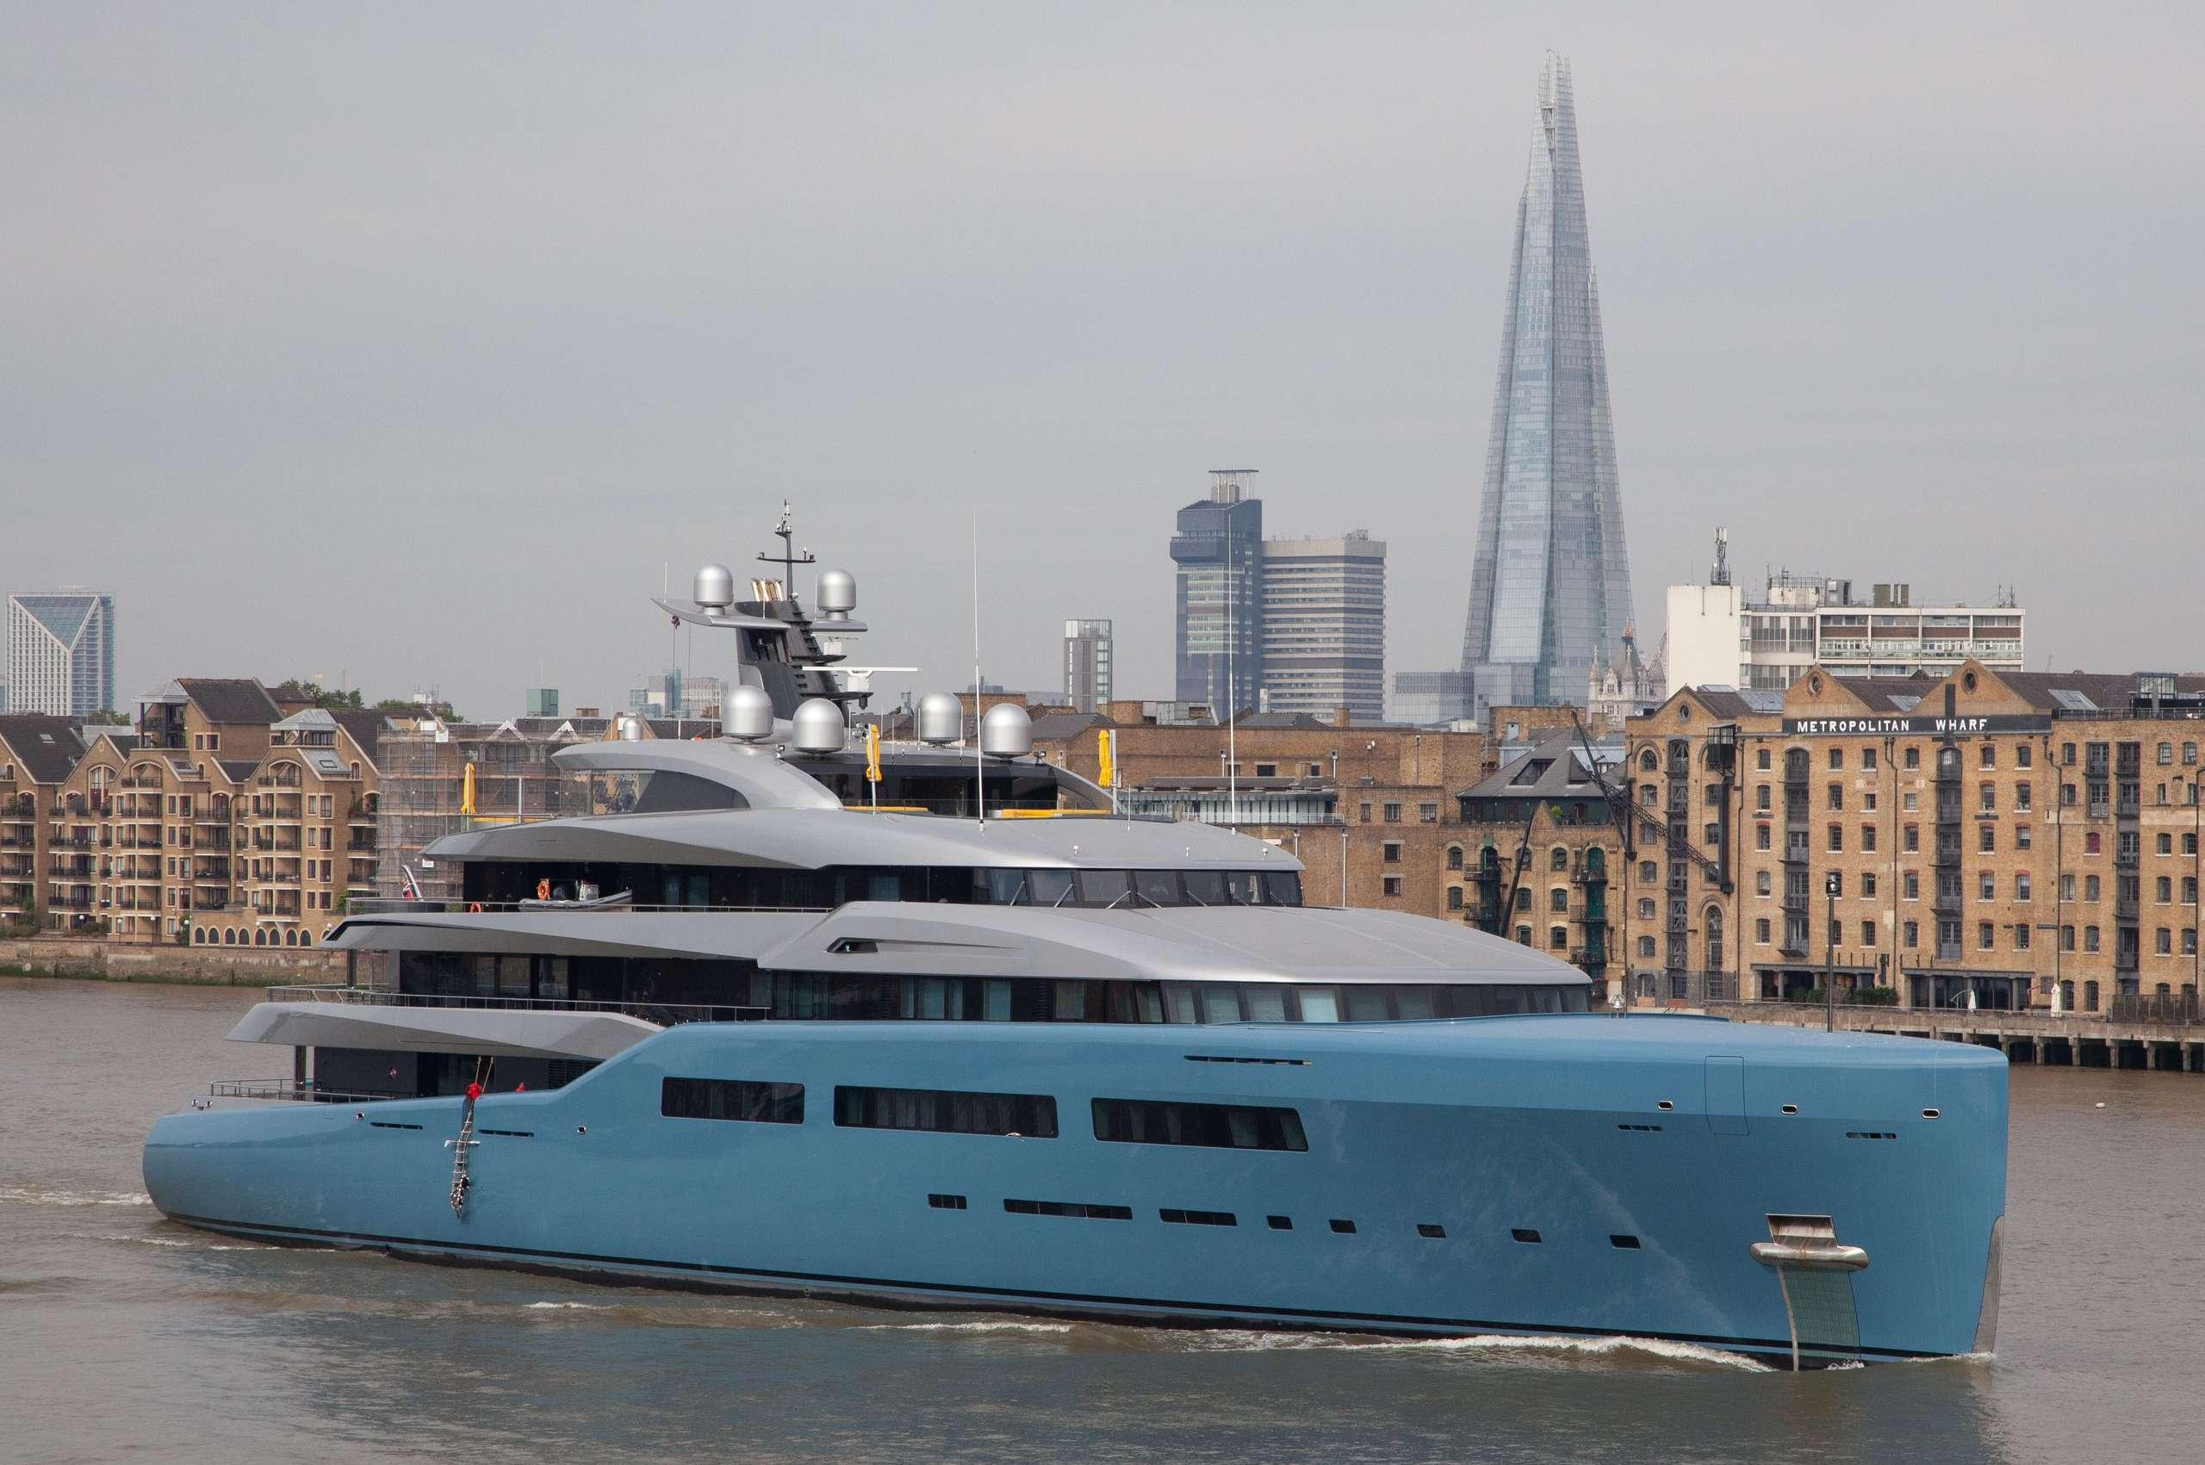
About me: Vladimir CM Sobota
B.Eng. Maritime Engineering
M.Sc. Management of Technology
Specialization: Economics and Finance
PhD: ‘Platform Ecosystems: Exploring Participation and Performance’

Slide 4
An anecdote
Valuating Uber

Slide 5
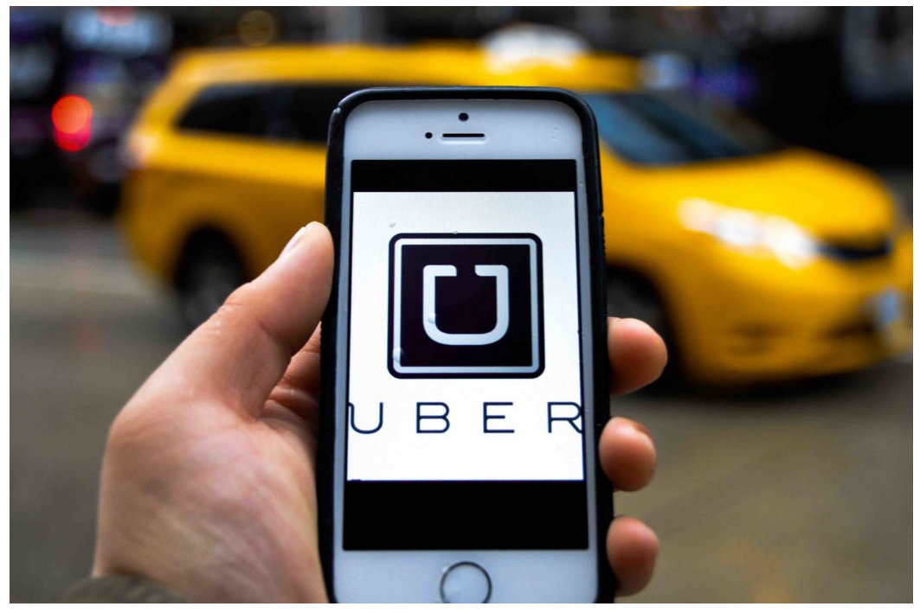
Intro: Uber
Source: https://gazettereview.com/2017/09/canada-uber-stop-operating-quebec-province/
Notes:
Ride hailing company
Founded 2009
Market cap 2021 $91B
2022: 47,9B
2023: 59,81B
2023 sept. 976,93B

Slide 6
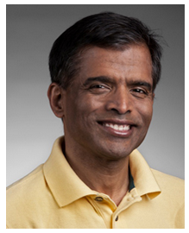
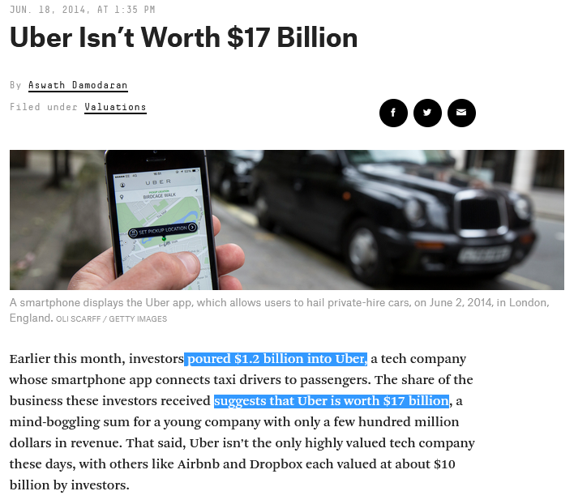

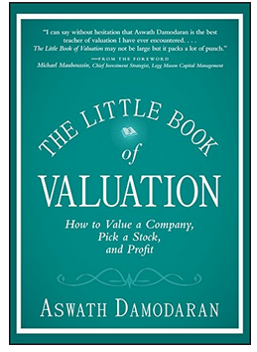
Intro: Damodaran vs Gurley
Prof. Aswath Damodaran,
NYU
Source: https://fivethirtyeight.com/features/uber-isnt-worth-17-billion/
Notes:
Context: 2014: Uber was raising 500M, valuing it at 17B
Total available market
Global taxi market estimated at $100Billion
Total available market
NPV of cash flows. cash flows depends, mostly, on three things:
the size of its potential market,
the size of Uber’s share in that market,
and what percentage of gross receipts Uber takes.
5,7 Billion: his estimate.

Slide 7
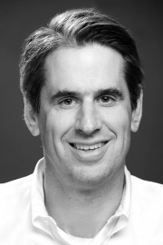
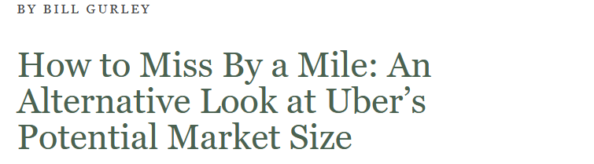
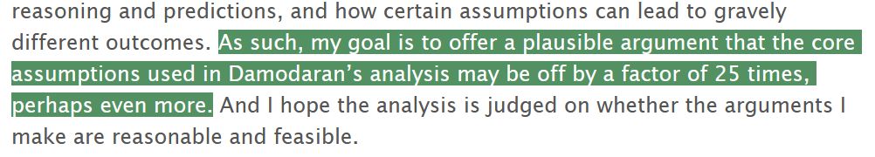
Intro: Damodaran vs Gurley
Source: https://abovethecrowd.com/2014/07/11/how-to-miss-by-a-mile-an-alternative-look-at-ubers-potential-market-size/
https://en.wikipedia.org/wiki/Bill_Gurley
Notes:
Series A investor and at-the-time boardmember
Criticizing TAM (total available market)
IN 2014, uber’s revenue in SF was already a multiple of the historic cab market

Slide 8
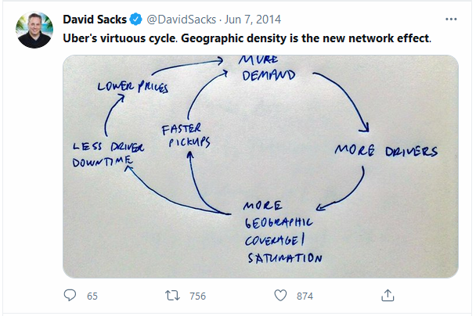
Dispute between ‘old’ and ‘new’ → whats different?
Or:
Notes:
Platforms as a way to organize resources / organizational form / innovation cannot be ignored
David Sacks: veteran of paypal, cofounder of yammer, investor
Professor schat de waarde van Uber veel lager in dan de investoren → hij had netwerk effecten niet meegenomen
Innovatie-impact niet meegenomen.
20th century: supply economies of scale
Now: demand economies of scale
This cycle makes Uber cheaper and cheaper, eating in to the car-ownership-alternative market rather than only the taxi market,
Well, does it?

Slide 9
Content:
What is a platform
Types of platforms
Platforms: Innovation impact
Summary
Focus: technology platforms/
Platform ecosystems

Slide 10
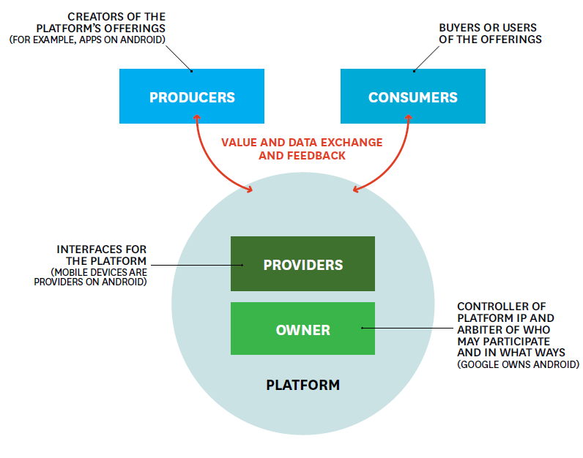
What is a platform?
Gawer, 2014:
Federate agents
Econ. of scale and scope
Modular architecture, core and periphery
Independent, yet interdependent actors
Technological component
Business component
Van Alstyne et al., 2016, p. 6
Notes:
Schematic representation of uber
1) federate and coordinate constitutive agents who can innovate and compete; (2) create value by generating and harnessing economies of scope in supply or/and in demand; and (3) entail a modular technological architecture composed of a core and a periphery.
(Gawer, 2014)

Slide 11
What is a platform?
Gawer, 2014:
Federate agents
Modular architecture, core and periphery
Van Alstyne et al., 2016, p. 6
Notes:
Modularity: division into separate, self-contained, and interchangeable modules.

Slide 12
What is a platform?
Gawer, 2014:
Federate agents
Modular architecture, core and periphery
Van Alstyne et al., 2016, p. 6
Notes:
Schematic representation of uber
1) federate and coordinate constitutive agents who can innovate and compete; (2) create value by generating and harnessing economies of scope in supply or/and in demand; and (3) entail a modular technological architecture composed of a core and a periphery.
(Gawer, 2014)

Slide 13
Platforms in the past
Examples?

Slide 14
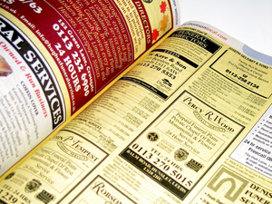
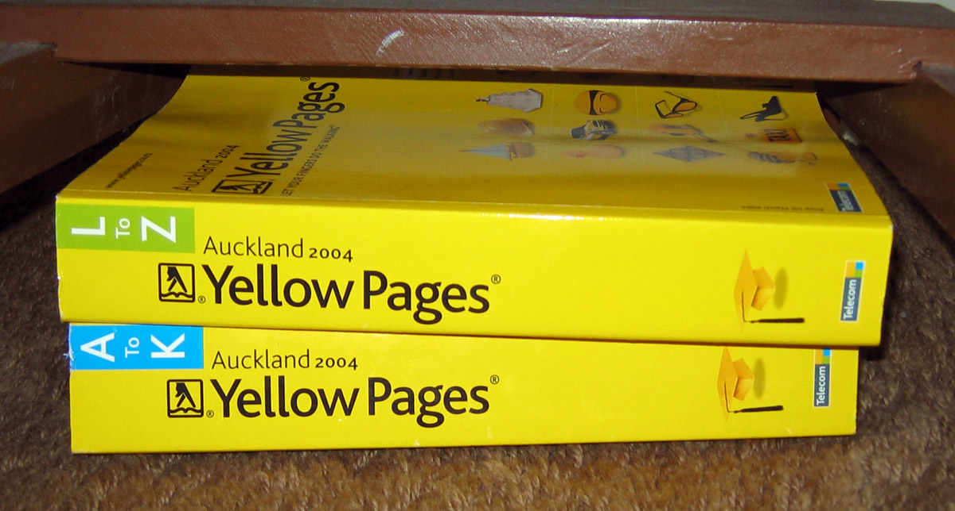
Platforms in the past
Notes:
Yellow pages: how do they work?
Registry of business: organized by category, rather than alphabetically, advertising is sold.
https://upload.wikimedia.org/wikipedia/commons/9/90/Auckland_Yellow_pages.jpg
https://www.independent.co.uk/news/business/news/yellow-pages-in-uturn-over-hibu-brand-9543137.html

Slide 15
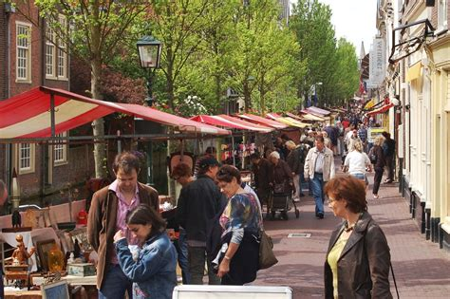
Platforms in the past
Notes:
Village chief would take a share of the turnover / profits
Other example: dating bars, trade shows
What is the consequence of not internalizing transactions?
Curation more difficult
Trust more difficult
https://mikestravelguide.com/things-to-do-in-delft-stroll-through-the-markets/antiques-and-more-at-delft-market/

Slide 16
Platforms in the past
‘dumb platforms’
→transactions not internalized
Notes:
Village chief would take a share of the turnover / profits
Other example: dating bars, trade shows
What is the consequence of not internalizing transactions?
Curation more difficult
Trust more difficult
https://mikestravelguide.com/things-to-do-in-delft-stroll-through-the-markets/antiques-and-more-at-delft-market/

Slide 17
Network effects: two types
Or:
Notes:
Mechanism!
Direct network effects: Uber Pool
Evans & Schmalensee 2010: “In practice, we believe businesses based on direct network effects are rare and that indirect network effects are a far more pervasive and important phenomenon.”
Network effects create virtuous cycle. Brand effects and price effects help, but don’t create these cycles.
Increasing returns!
Can you spot negative feedback loops in this slide?
New uses: send kids somewhere, use it more often as it is cheaper, avoid parking costs, use by old drivers, get rid of marginal car

Slide 18
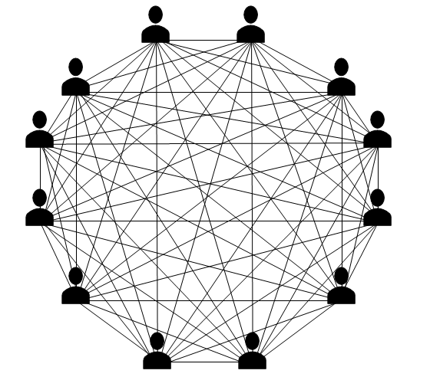
Network effects: two types
Indirect NE
Or:
Direct NE
Notes:
Mechanism!
Direct network effects: Uber Pool
Users benefit from more users, but only via more drivers → indirectly!
Evans & Schmalensee 2010: “In practice, we believe businesses based on direct network effects are rare and that indirect network effects are a far more pervasive and important phenomenon.”
Network effects create virtuous cycle. Brand effects and price effects help, but don’t create these cycles.
Increasing returns!
Can you spot negative feedback loops in this slide?
New uses: send kids somewhere, use it more often as it is cheaper, avoid parking costs, use by old drivers, get rid of marginal car
https://media.licdn.com/dms/image/D5612AQF-BoIUaa7UoQ/article-cover_image-shrink_720_1280/0/1654694418222?e=2147483647&v=beta&t=VRgZiK_LmGpwDFz_yoKis0lLPeUaJKgo4A0jlqOoF24

Slide 19
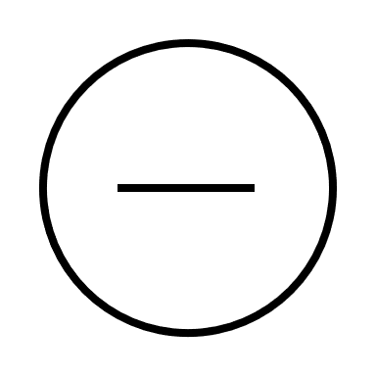
Network effects: two types
Or:
Notes:
Mechanism!
Direct network effects: Uber Pool
Network effects create virtuous cycle. Brand effects and price effects help, but don’t create these cycles.
Can you spot negative feedback loops in this slide?
New uses: send kids somewhere, use it more often as it is cheaper, avoid parking costs, use by old drivers, get rid of marginal car
But: supply-effects of scale still matter! In fact, uber may not possess these as much as this sketch suggests.

Slide 20
Network effects:
Create positive feedback loops!
Market expansion
Prices may fall as quantity increases, but only network effects create positive feedback
Spend money to attract participants.
Notes:
Not only temporarily, but it also sometimes makes sense to subsidize one side continuously.

Slide 21
Pipeline → Platform (Van Alstyne et al. 2016)
Resources: control → orchestration
Internal optimization → external interaction
Value: customer → ecosystem
Notes:
Resource control → orchestration VRIN:
Pipeline: tangible (mines, production lines, real estate), intangible (IP)
Platform: community, resources contributed and owned by members → network
Internal optimization → external interaction
Pipeline: Optimize chain of product activities, mostly internal, Material to sales to service
Platforms: facilitate interaction between external producers and consumers, dictation → persuasion
Main skill: ecosystem governance
Value: customer → ecosystem
Pipeline: maximize customer value, end of linear process
Pipelines do not normally charge negative prices!
Platform: maximize total value of ecosystem. May require subsidizing of one side.

Slide 22

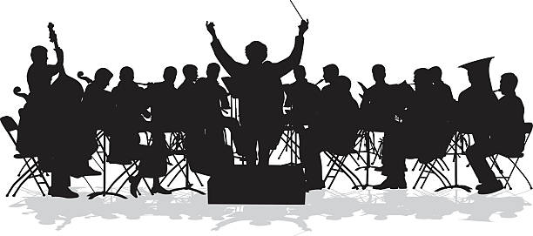
Pipeline → Platform (Van Alstyne et al. 2016)
Resources: control → orchestration
Notes:
Resource control → orchestration VRIN:
Orchestration: the planning or coordination of the elements of a situation to produce a desired effect, especially in a way that attempts to avoid notice or attention; secretively (Oxford languages)
Control: the power to influence or direct people's behaviour or the course of events (Oxford languages)
Pipeline: tangible (mines, production lines, real estate), intangible (IP)
Platform: community, resources contributed and owned by members → network
https://www.google.com/url?sa=i&url=https%3A%2F%2Fwww.istockphoto.com%2Fillustrations%2Forchestra&psig=AOvVaw2EfoekaHnUwnxfQJ6zpkrm&ust=1694763034345000&source=images&cd=vfe&opi=89978449&ved=0CBAQjRxqFwoTCKig5bbKqYEDFQAAAAAdAAAAABAE

Slide 23
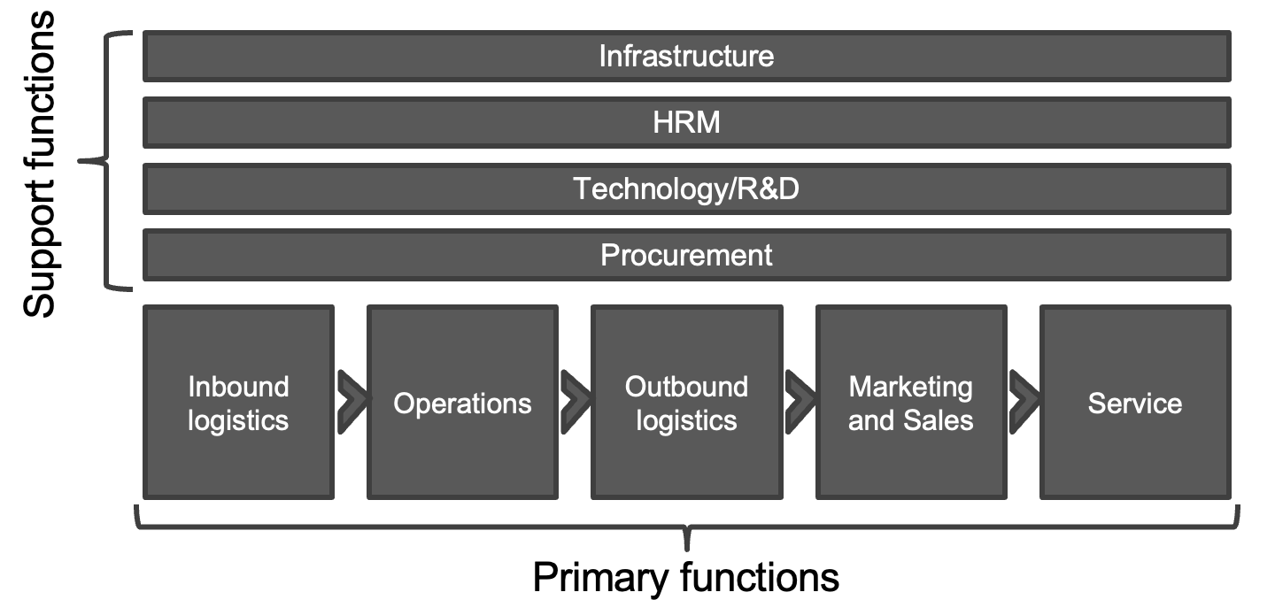
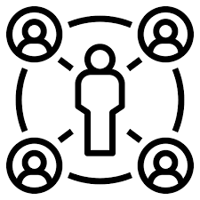
Pipeline → Platform (Van Alstyne et al. 2016)
Internal optimization → external interaction
Notes:
Internal optimization → external interaction
Pipeline: Optimize chain of product activities, mostly internal, Material to sales to service
Platforms: facilitate interaction between external producers and consumers, dictation → persuasion
Main skill: ecosystem governance

Slide 24
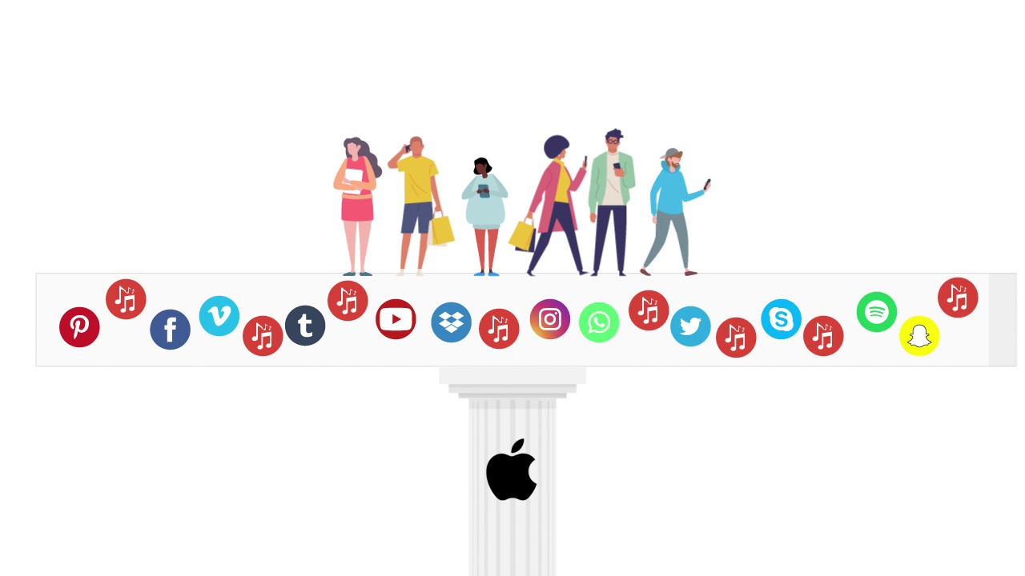

Pipeline → Platform (Van Alstyne et al. 2016)
Value: customer → ecosystem
Notes:
Value: customer → ecosystem
Pipeline: maximize customer value, end of linear process
Pipelines do not normally charge negative prices!
Platform: maximize total value of ecosystem. May require subsidizing of one side.
Sometimes, matching works too well. Then, little value is created for advertisers! Matching can sometimes be artificially slowed.
https://www.google.com/url?sa=i&url=https%3A%2F%2Fm.youtube.com%2Fwatch%3Fv%3DJ0kdOlqgF6E&psig=AOvVaw0OJtAVoblCA-_IGa0GfELU&ust=1694792053609000&source=images&cd=vfe&opi=89978449&ved=0CBAQjRxqFwoTCPi2q8S2qoEDFQAAAAAdAAAAABAE

Slide 25
Content:
What is a platform
Types of platforms
Platforms: Innovation impact
Summary

Slide 26
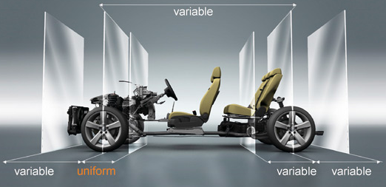

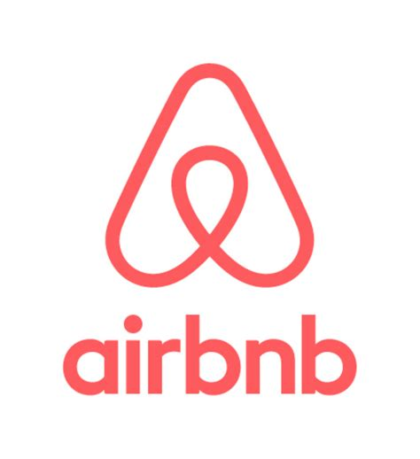

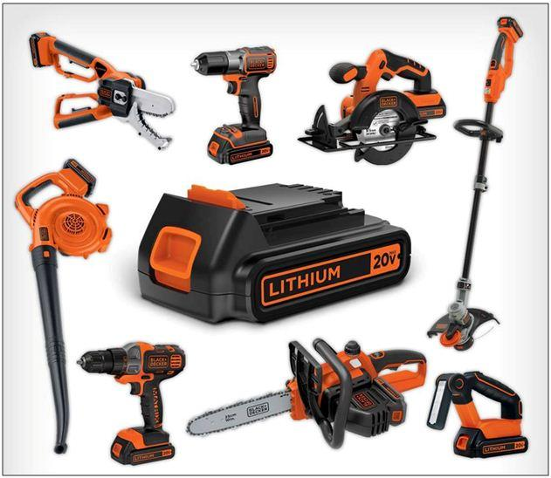
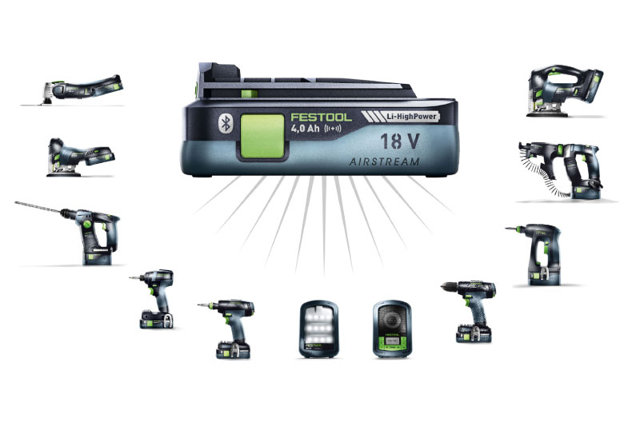


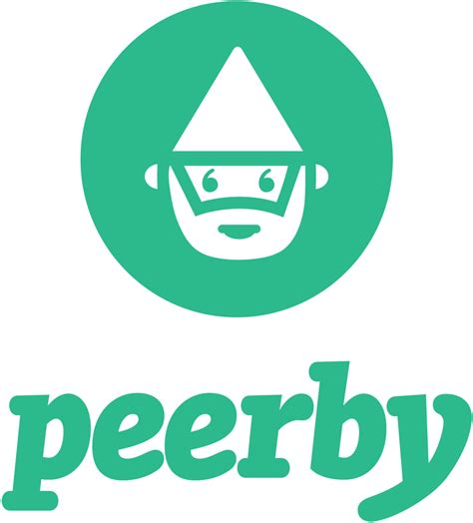
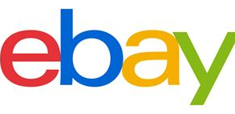

Platforms: Two perspectives
Gawer and Cusumano, 2014, p. 418
Internal platform
External platform
“… set of assets organized in a common strucure from which a company can efficiently develop and produce … derivative products”
“…upon which outside firms can develop complementary, products, technologies, or services”
Notes:
Main points: within hierarchies, across hierarchies
There’s more types of platforms than just matchmakers
On the right: network effects are the main mechanism. But what is it on the left?
Economies of scope.

Slide 27
Content:
What is a platform
Types of platforms
Platforms: Innovation impact
Summary

Slide 28
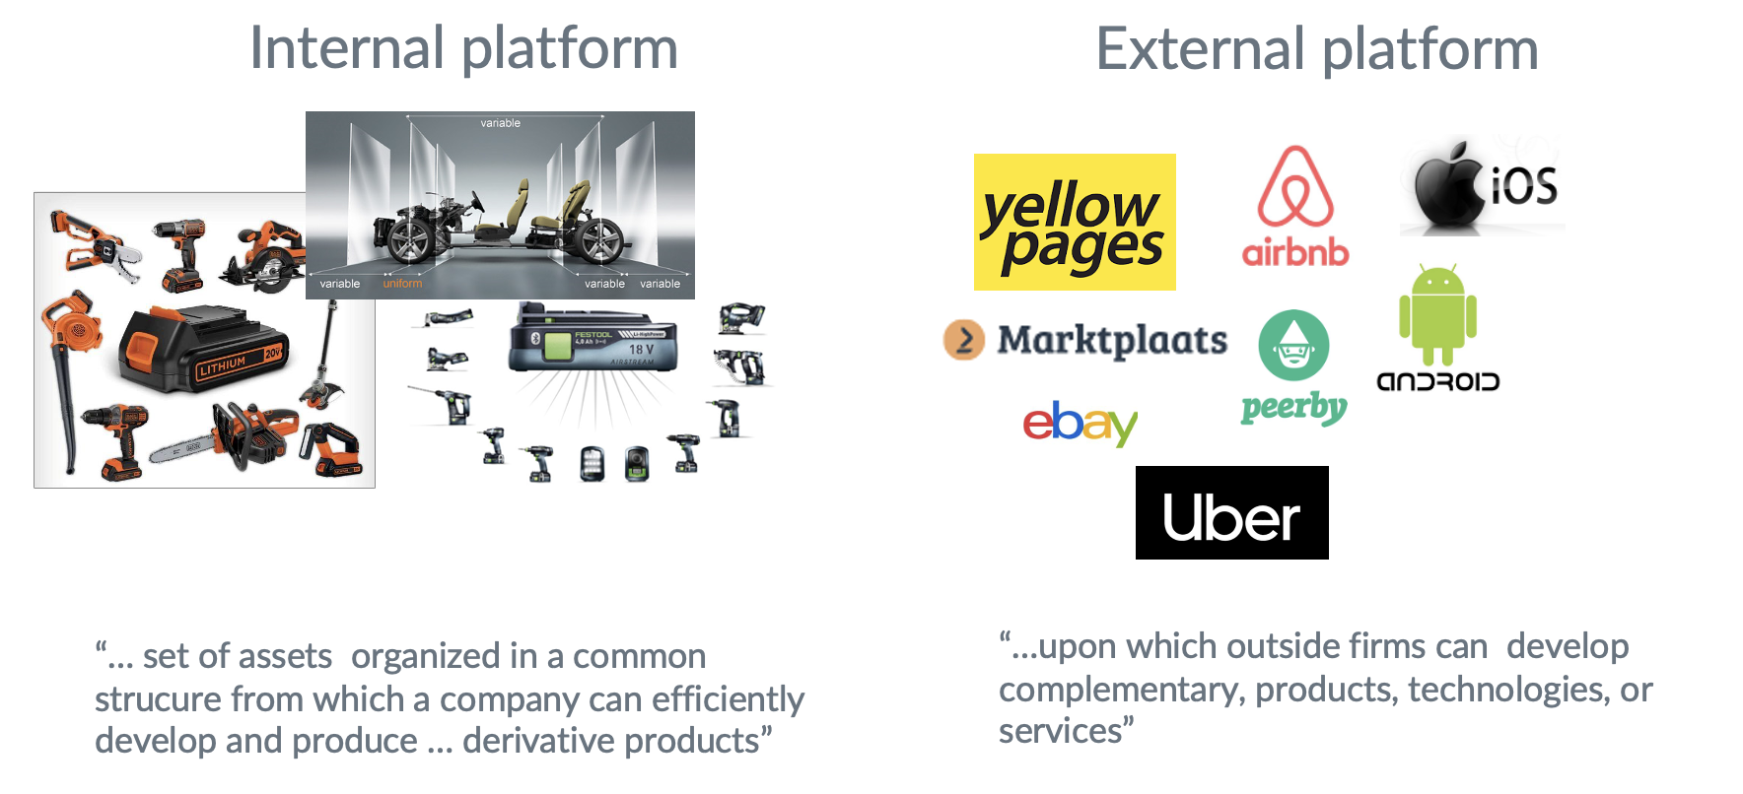
Third part: Platform type x innovation
“what impact has this organizational form on innovation”
Notes:
Rather than: “how can internal innovation platforms innovate”

Slide 29
Platform type x innovation
Internal innovation platforms:
Product family
Set of new features
→ product platforms
Innovation impact:
Product variety ↑
Time to market ↓
Inventory / product cost ↓
→within boundaries!
Design principles:
Modularity
Core and periphery
Stable interfaces and architecture
Mechanism:
Economies of scale and scope
Notes:
E.g., VW has a fully-electric platform (MEB), and a conventional platform (MQB)
Winterkorn against electric platform, later on: realization that this is not efficient enough
PSA bets on a multi-energy platform
Creating this platform: boundary! Within boundary quicker innovation, but not outside of the boundary

Slide 30
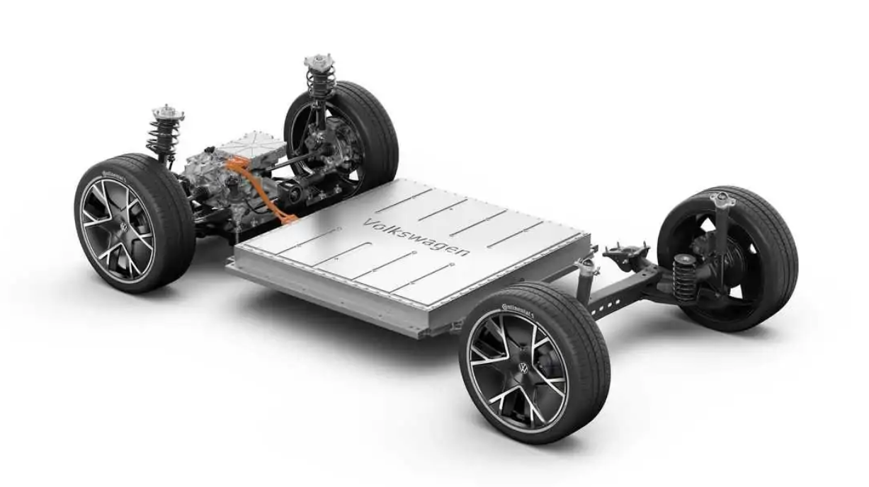
For instance…
Notes:
https://www.motor1.com/news/586852/vw-mahindra-meb-electric-components-deal/
MQB en MEB platforms
Here, an electric motor with variable stack length but fixed axial diameter kept housing dimensions common and allowed Black & Decker to produce derivative products at lower cost and greater speed.

Slide 31
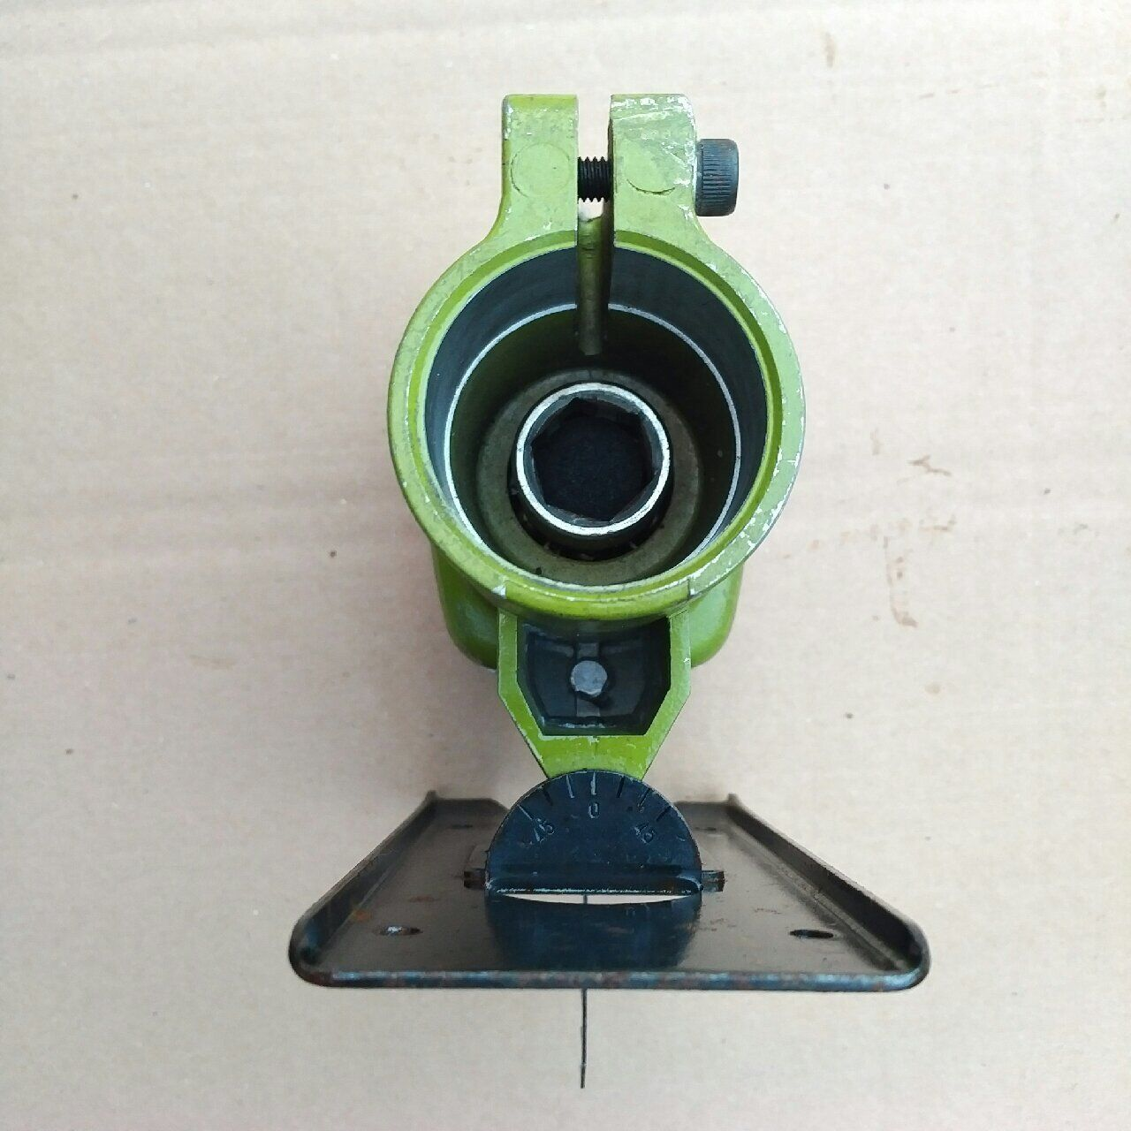
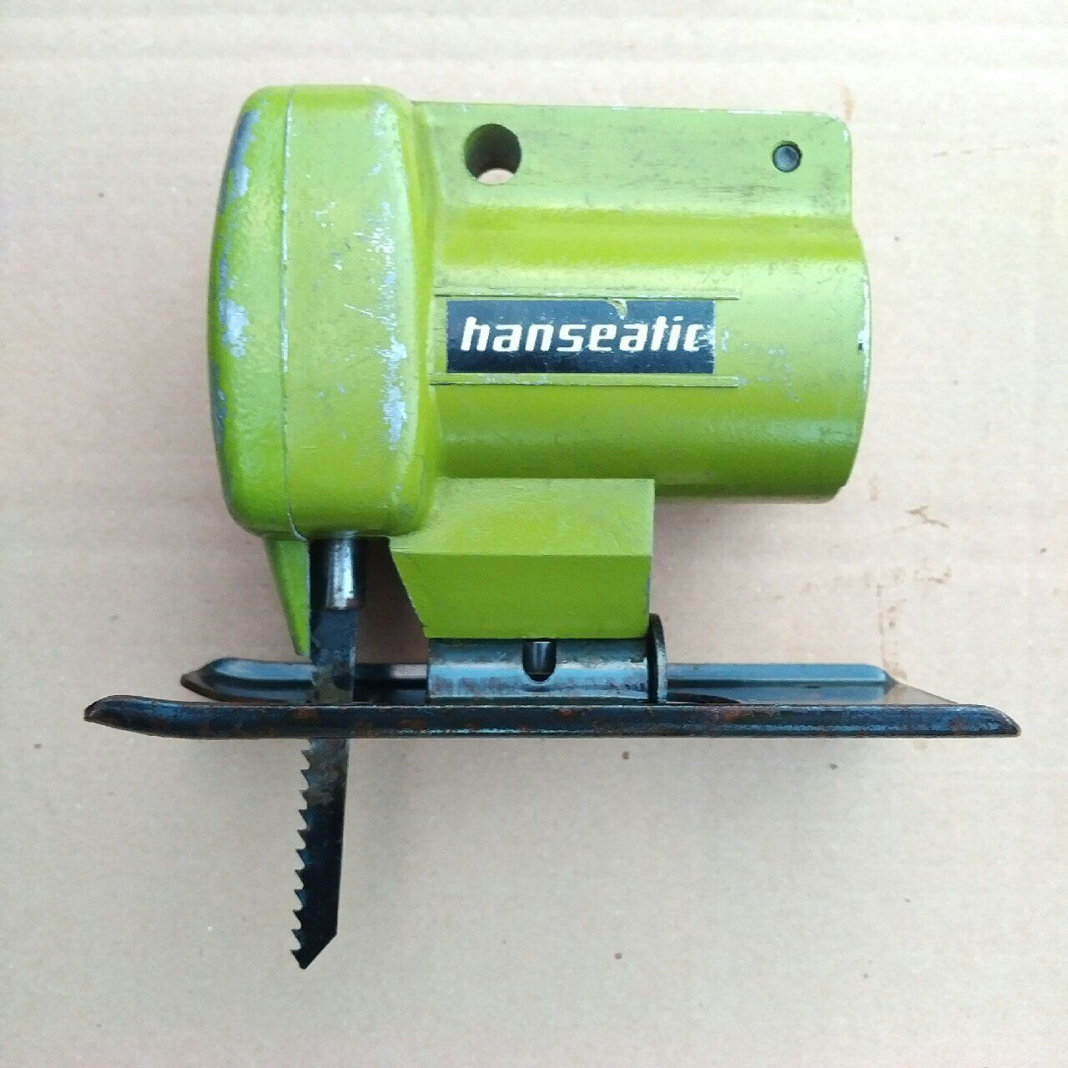
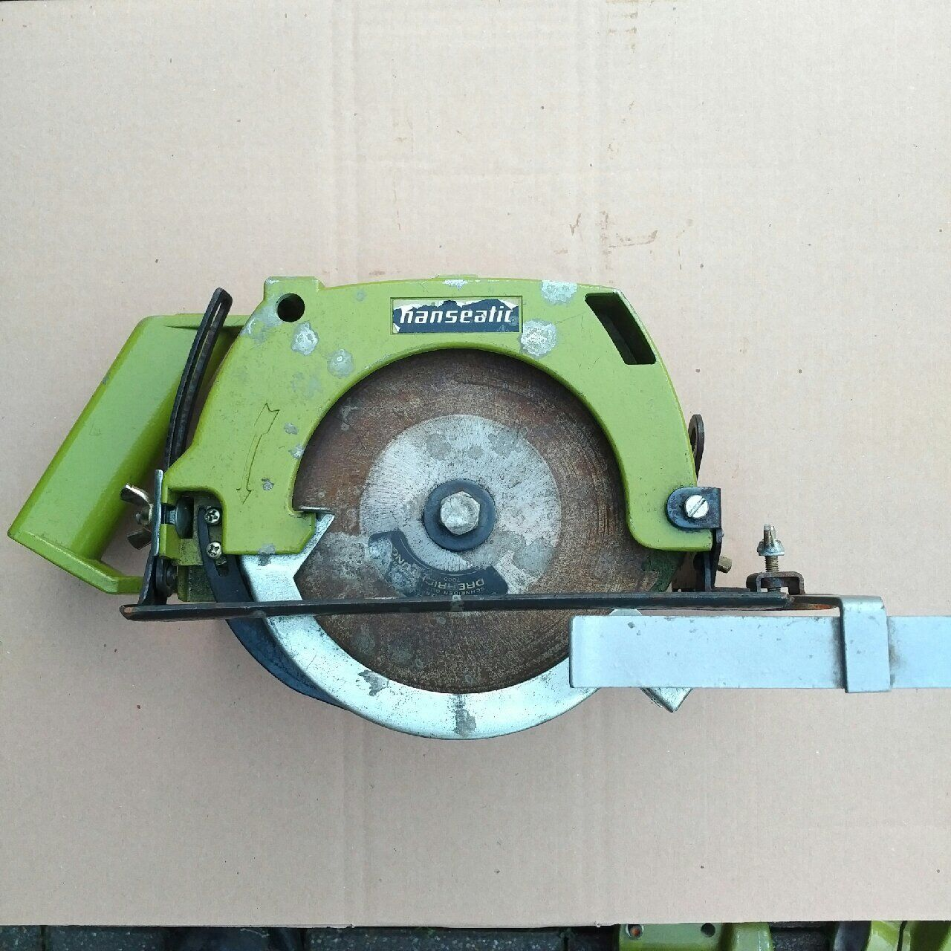
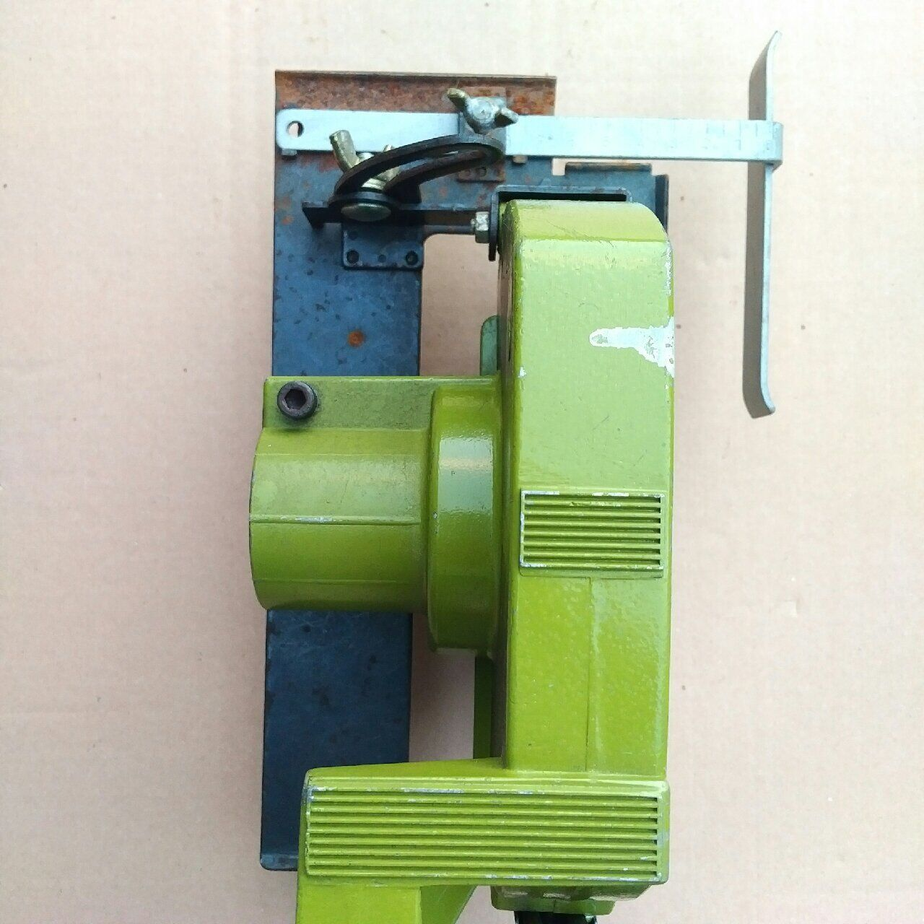
Modularity: division into separate, self-contained, and interchangeable modules.
Modularity: division into separate, self-contained, and interchangeable modules.
Notes:
https://www.ebay.de/itm/204395397816?hash=item2f96ea42b8:g:sDAAAOSwx2VZg4wI

Slide 32
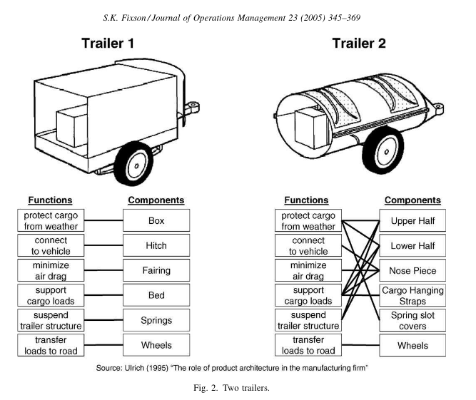
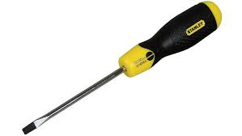
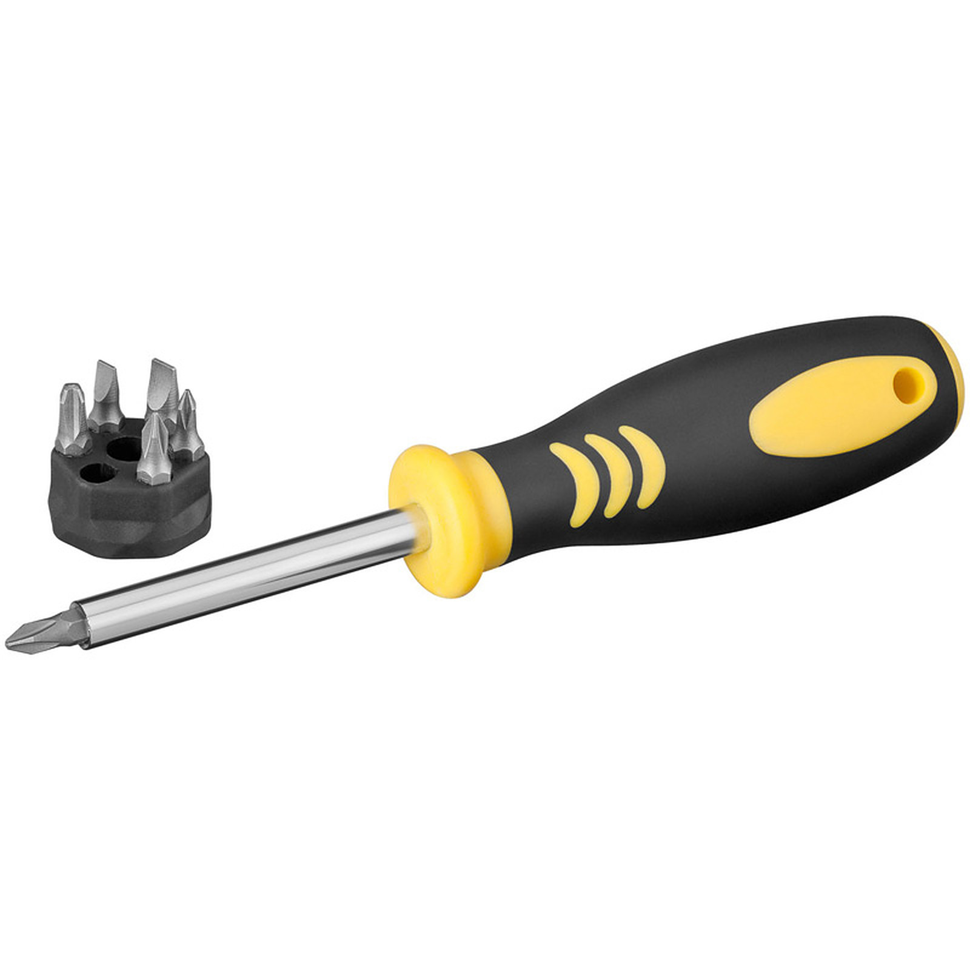
Modularity
Fixson 2005, p 352
Notes:
Modularity: division into separate, self-contained, and interchangeable modules.

Slide 33
Internal platforms:
Main Mechanism: Economies of scope (Teece 1980)
Notes:
Multiproduct enterprise:
Why is General Motors not dominant in the coal business?
Why doesn’t Volkswagen make airplanes?
Diversification → mechanism for capturing integration economies

Slide 34
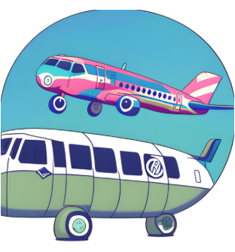
Internal platforms:
Main Mechanism: Economies of scope (Teece 1980)
Why doesn’t Volkswagen make airplanes?
Why is General Motors not dominant in the coal business?
Why does Black&Decker produce a whole range of battery-driven power tools?
Notes:
Multiproduct enterprise:
Why is General Motors not dominant in the coal business?
Why doesn’t Volkswagen make airplanes?
Diversification → mechanism for capturing integration economies

Slide 35
Internal platforms:
Main Mechanism: Economies of scope (Teece 1980)
→Cost of join production is less than producing each output separately.
Arise when knowledge, production facilities, resources, marketing expertise, etc. can be shared across product lines.
Product platforms: way of creating econ. of scope
Notes:
Multiproduct enterprise:
Why is General Motors not dominant in the coal business?
Why doesn’t Volkswagen make airplanes?
Diversification → mechanism for capturing integration economies

Slide 36
Platform type x innovation (2)
External innovation / industry platform
Ecosystem of third-party complementors
Platform leader, but no ‘master designer’
Innovation impact:
Product variety ↑
Time to market ↓
Complementary service innovation
Transaction cost ↓
Scope not fully determined
Long tail, market creation (see Uber)
Design principles:
Modularity
Open stable interfaces and architecture
Core and periphery
Mechanism:
(Indirect) network effects
Aggregation (niches)
Economies of scale and scope
Reduced transaction cost
Pricing
(Anderson, 2004)
Notes:
Master orchestrator, but no master designer
Internal → closed interfaces, case to case basis
Millions of apps made for Android, but only close to 100 developed by google
‘complements’ / functionality may be moved into the core (siri, torch, airdrop)
Second, the literature indicates that complementors have a higher degree of radical innovativeness than platform owners (Jugend et al., 2018)
-Finally, research shows that complementors have a preference for fluid innovation activities, including networking and informal knowledge sourcing (Dahlander & Gann, 2010).
Criticism of the long tail story: https://medium.com/before-the-dot/the-long-tail-when-a-famous-theory-got-almost-all-wrong-12d3c6eb0de9
Long-tail: ecommerce, not only platforms, but also platforms. E.g., books that are out of print may still be found on marktplaats or amazon market place. Ecommerce will fatten and stretch the tail
Not exactly true: flatten en make longer
https://medium.com/before-the-dot/the-long-tail-when-a-famous-theory-got-almost-all-wrong-12d3c6eb0de9
Hit products became even more concentrated than they were before
Users of very niche products are usually very active users, consuming niche AND blockbuster products
→ the most active users will look for niche products, hence offer these to attract them

Slide 37
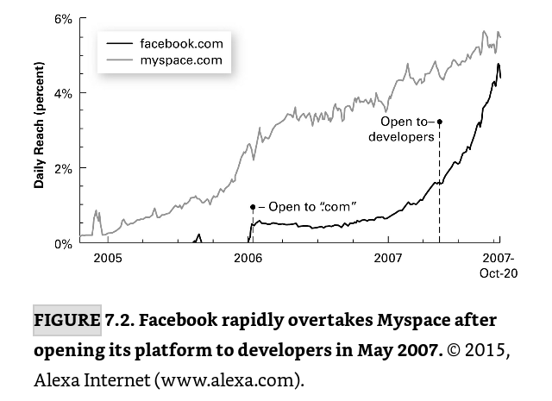
For example…
Facebook platform evolution (left), Growth fb vs myspace (right)
Helmond et al., 2019, p 130
https://osf.io/unbxw/
.
Parker et al, 2016, p. 133
Notes:
Dit is ook het narratief wat mensen vertellen
https://osf.io/unbxw/
Left: evolution of platform boundaries
Founder of myspace: we didn’t ge the point of open innovation, we thought we could do it ourself.
Left: In our first line of enquiry, we traced the evolution of Facebook’s programmability and platform boundaries and visualized this over time
dot-com, is a company that conducts business primarily through a website.
Daily reach = percentage of internet users in touch

Slide 38
Content:
What is a platform
Types of platforms
Platforms: Innovation impact
Summary
Focus: technology platforms

Slide 39
Summary
What is a platform
Network effects
Modularity
Economies of scale / scope
Types of platforms
Internal / external
Innovation impact per type of platform
Notes:
Questions?

Slide 40
What is a platform?
Gawer, 2014:
Federate and orchestrate constitutive agents
Econ. of scale and scope
Modular architecture, core and periphery

Slide 41
That’s it
Any questions?
Questions? Ideas?
Discuss further?
Master thesis?
v.c.m.sobota@tudelft.nl

